Slide 1

SMS Spam Detection
Using Machine Learning
By Vishesh Jain(22BCS14469), Ranit Pal (22BCS14455), Veer Bajpai (22BCS14482), Jaydeep Kumar (22BCS14431)

Slide 2

INTRODUCTION
Short Message Service (SMS) is one of the trendy communication services in which a message is sent electronically. The reduction in the cost of SMS services by telecom companies has led to the increased use of SMS. This rise attracted attackers which have resulted in SMS Spam problem. A spam message is generally any unsolicited message that is sent to user’s mobile phone. Spam messages include advertisements, free services, promotions, awards, etc.

Slide 3

APPLICATION OF SPAM DETECTION
1. Spam detection enhance the overall user experience by preventing unwanted and intrusive SMS messages from reaching users' inboxes.
2. It serves as an essential line of protection against phishing and SMS-based frauds that try to trick users into disclosing personal information or doing dangerous things.
3. It safeguards user privacy by blocking unsolicited messages that may attempt to collect personal information without consent.
4. It reduces the amount of pointless SMS traffic, which optimizes network resources and makes sure they are used more effectively.

Slide 4

PROBLEM STATEMENT
The market for mobile phones has grown significantly in the last several years. In the second quarter of 2013, a total of 432.1 million mobile devices were shipped, representing a 6.0% increase year over year. With the increasing prevalence of smartphone purchases, Short Message Service (SMS) has grown to be a multibillion dollar industry. An increase in the volume of unsolicited commercial notifications sent to cell phones has also grown as a result of mobile platforms' growing popularity. Attackers were drawn to this increase, which led to the issue of SMS spam.

Slide 5

FUTURE SCOPE
The machine learning models should be trained using datasets with a large number of records and datasets from various sources in an effort to improve the findings. As a result, the models will be more reliable.
Use slang and abbreviations in messaging these days, which the models are unable to recognize at the moment.
To more accurately distinguish the real ham messages from the fake ones, this may be enhanced.

Slide 6
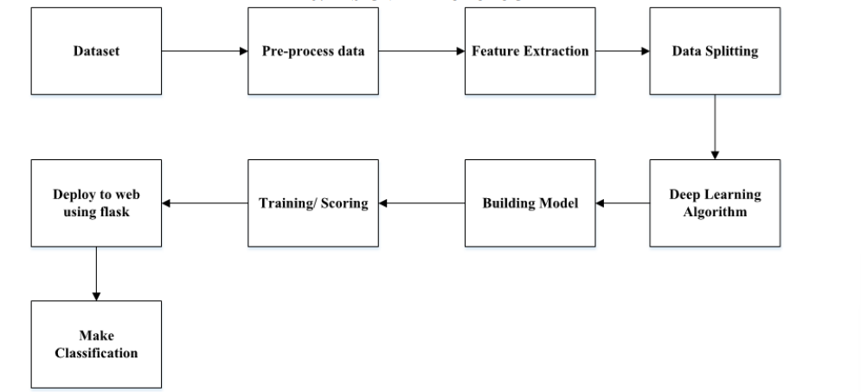
METHODOLOGY

Slide 7


